Slide 1
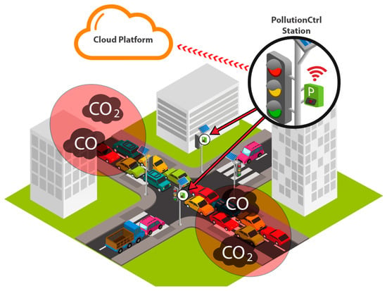
The Smart City Sentinel – A Modular PCB for Intelligent Environmental Monitoring
THE INNOVENGINEERS
Dhruvil Gohil (Captain)
Dhrish Jain
Devanshu Mistry
Eeshan Amdekar
Harsh Vasa
Pratham Gopani

Slide 2
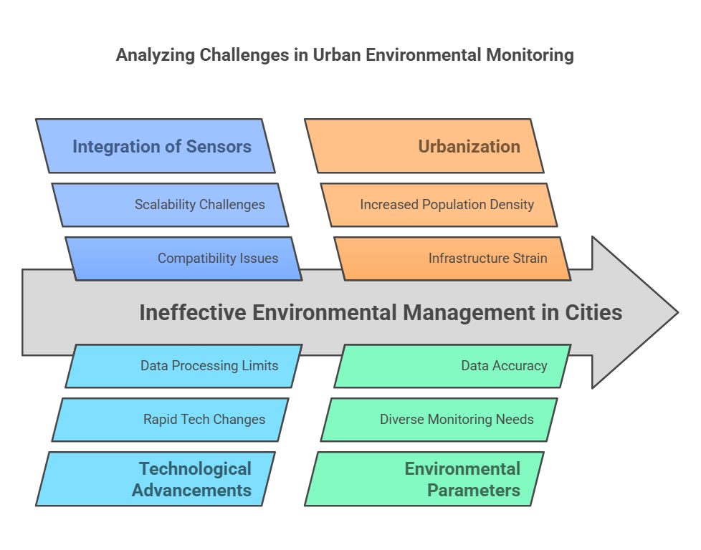

Slide 3
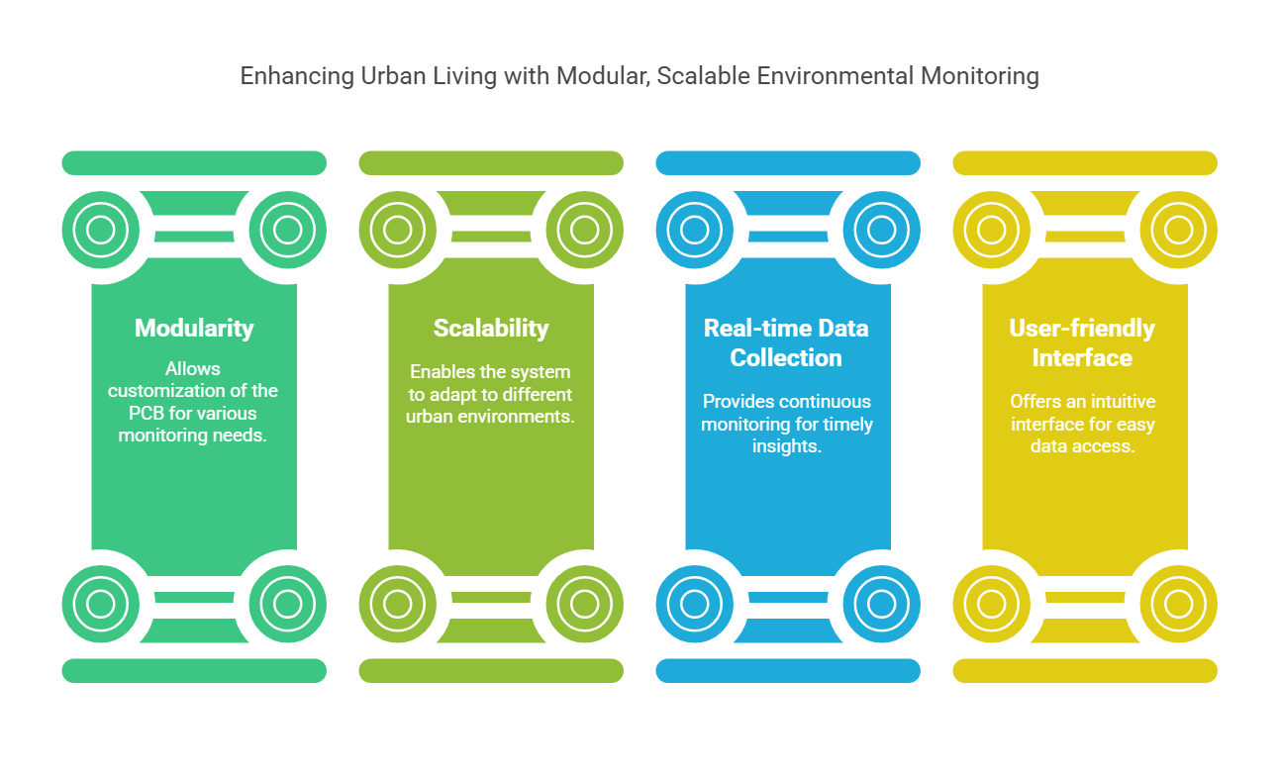

Slide 4
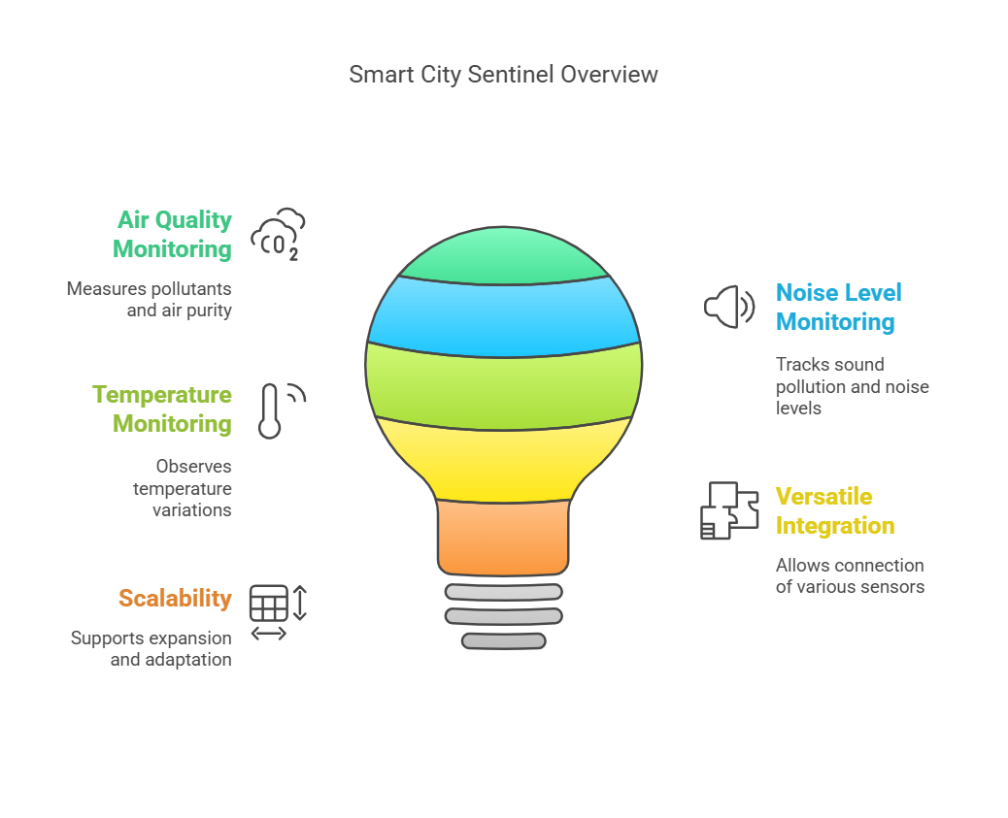

Slide 5
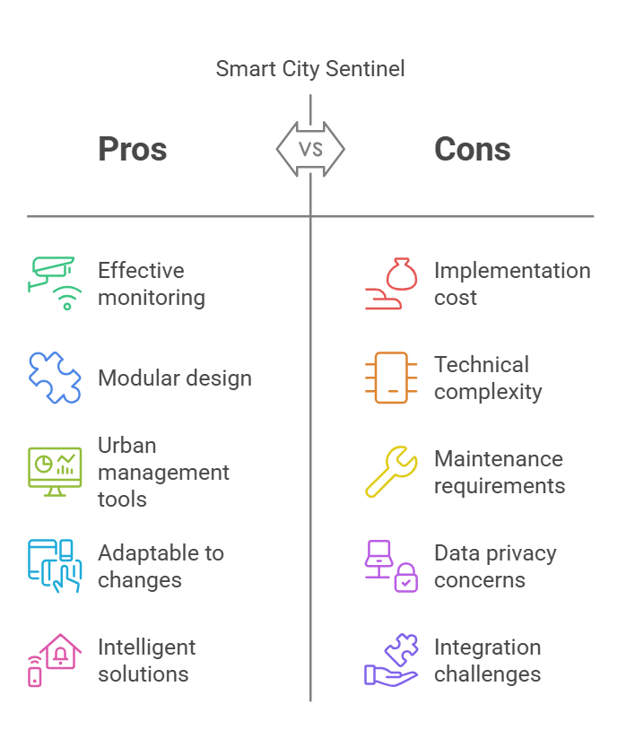

Slide 6
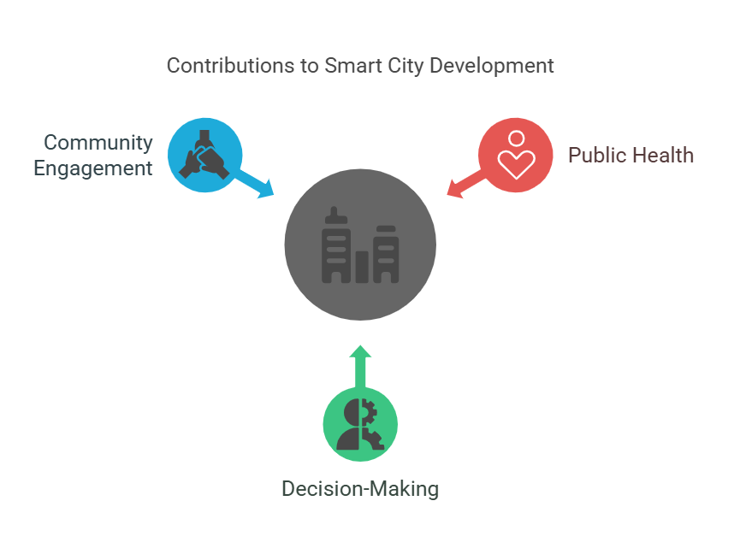

Slide 7
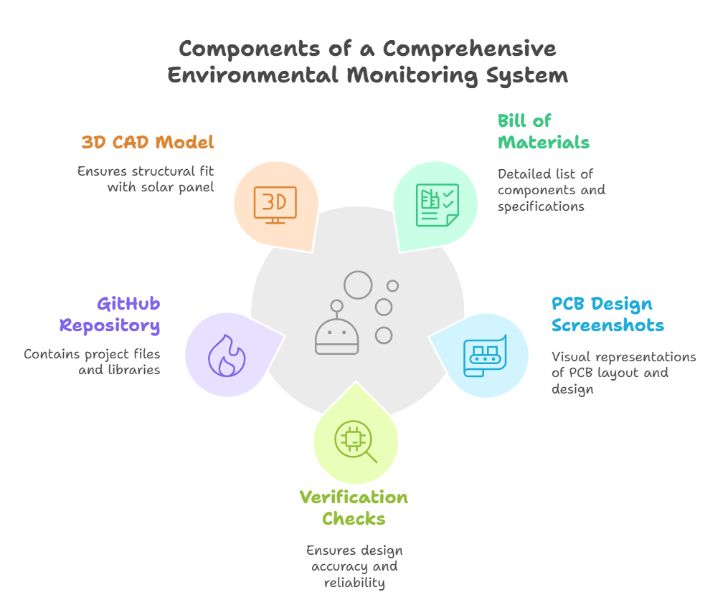

Slide 8
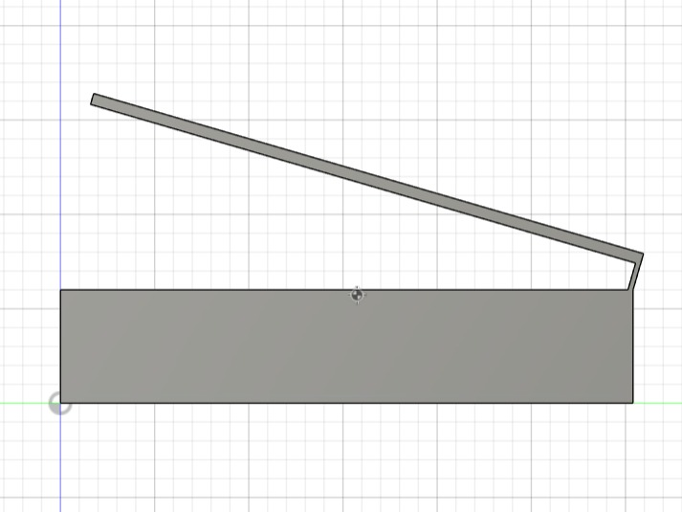
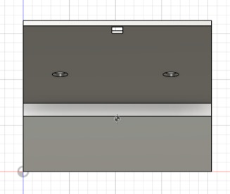
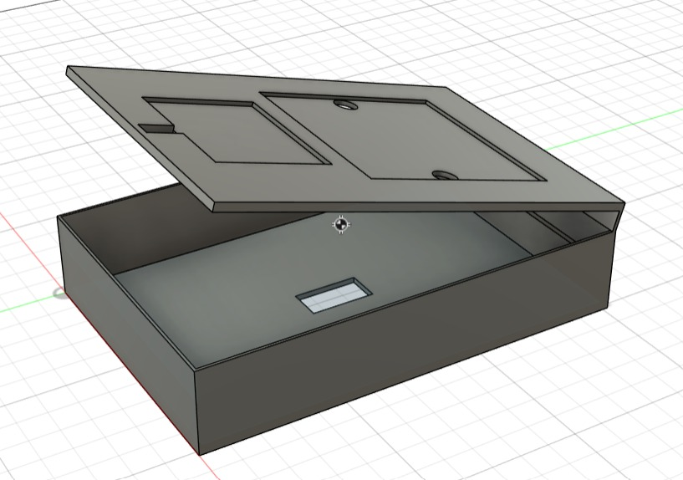
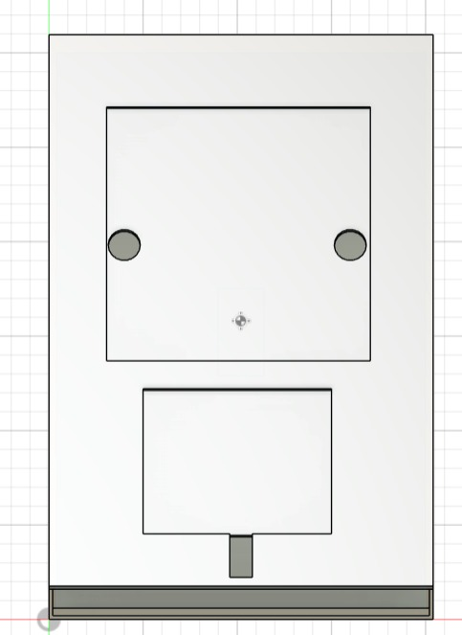
RHV
FV
ISOMETRIC VIEW
TV

Slide 9
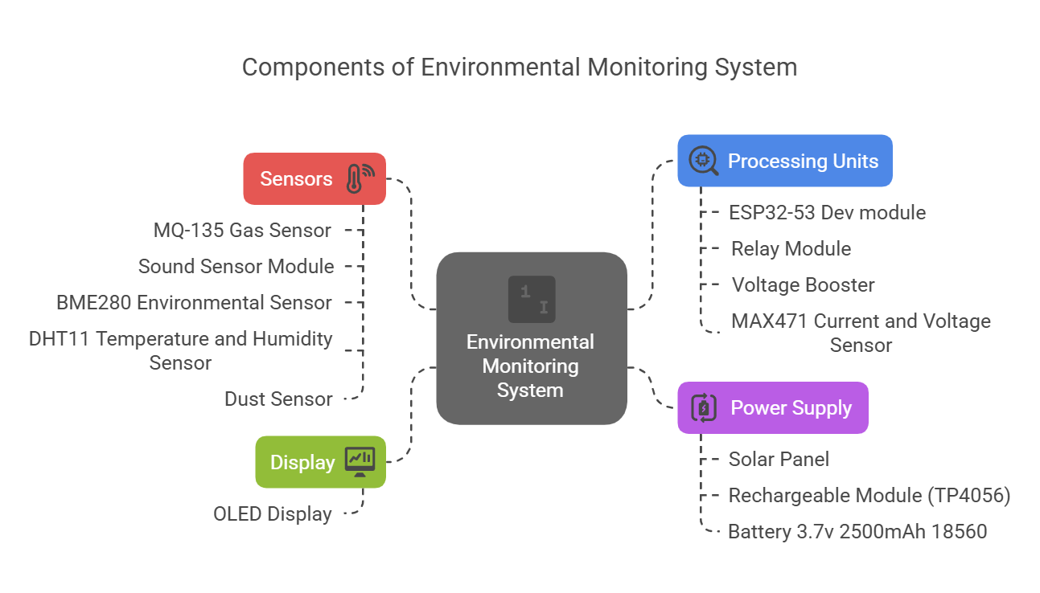

Slide 10
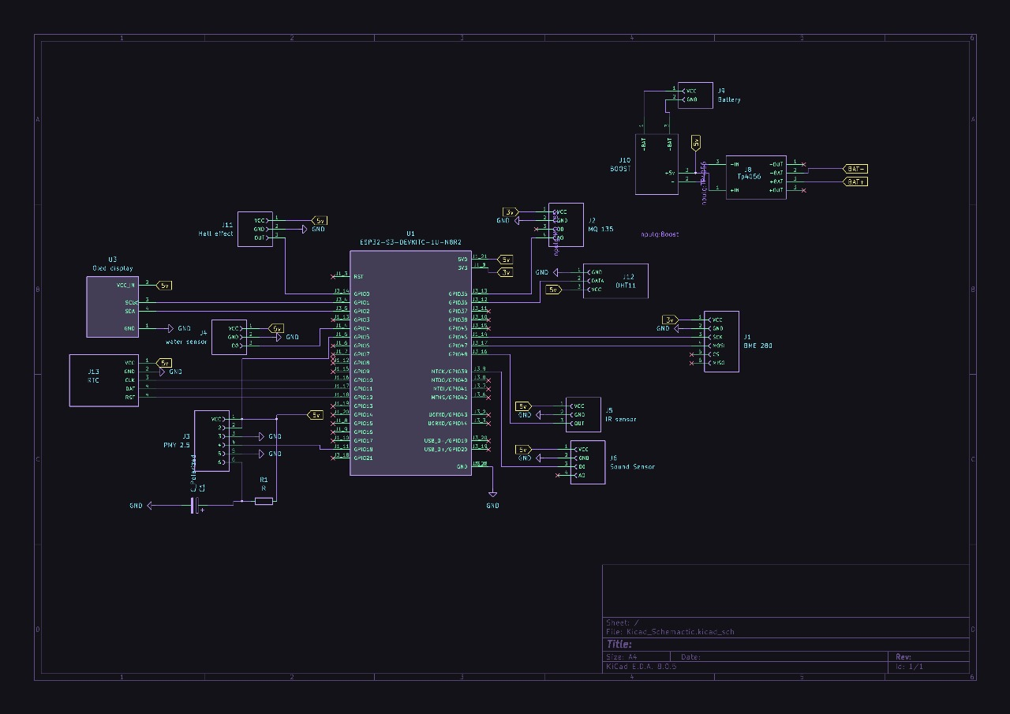

Slide 11
